Slide 1


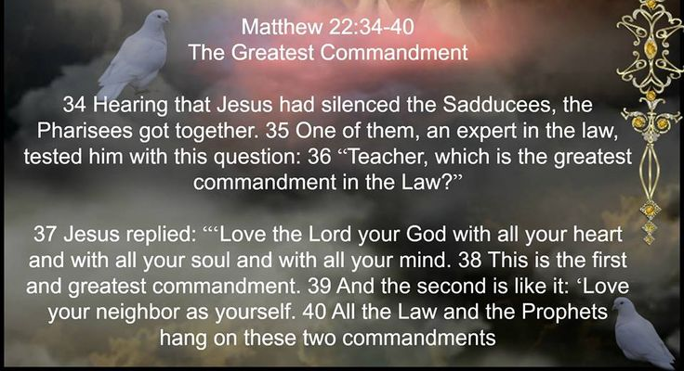
Belonging(People of God)
Key Vocabulary:
Key Question: How can following God bring freedom and justice?
Word | Definition
Know the story of Moses and identify how the story shows the concept of freedom as well belonging to the Hebrew people.
Know that the Hebrew people became the Israelites who were then the Jewish people.
Know that Jesus was born into the Jewish people and was a Jew.
Know that Jesus and his family and followers would have known about the 10 Commandments and would have tried to follow them.
Know that Jesus also gave rules for good living, in a more simplified way, found in: Matthew 22: 34-40.
BONUS: Know that Christianity only began after Jesus had died.

