Slide 1
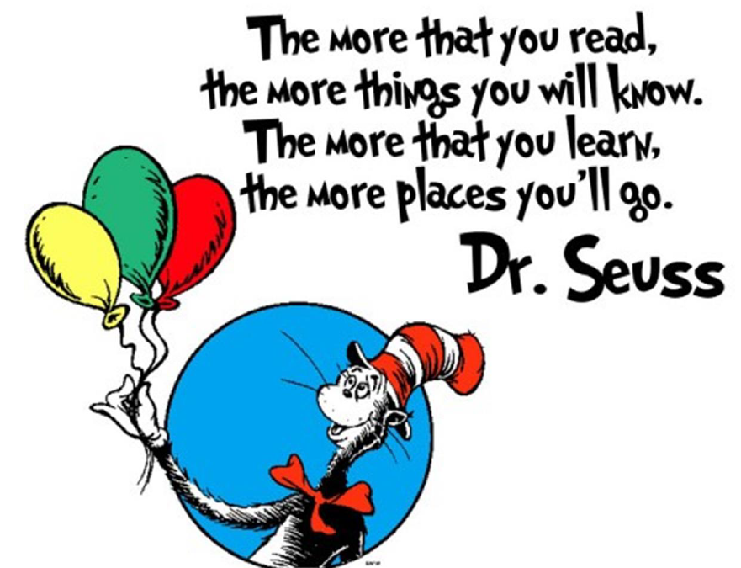
Parent reading Workshop January 2026

Slide 2
Why does it matter ?
When children choose to read, it strengthens wellbeing, engagement and a sense of belonging. It supports empathy and emotional understanding. It builds curiosity, self-regulation and a love of learning. It widens vocabulary and deepens knowledge across the curriculum.
There is also a clear opportunity. Children and young people report that they are far more likely to read when it connects with what they already care about. When books link to favourite films, TV series, games, sports or hobbies, motivation rises immediately

Slide 3
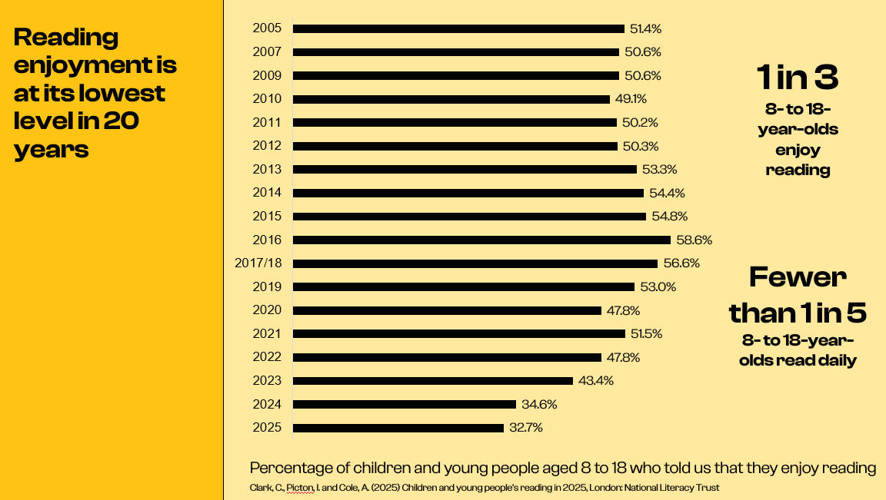
?
AI-driven technology, social anxiety, post-pandemic mental health challenges, increasing polarisation and a persistent achievement gap.
Focus of new curriculum so that children are equipped to articulate ideas, listen critically, and engage in respectful discussions that help them find their place in society.

Slide 4


The campaign goal
Click on the image to watch the campaign introduction video
Reverse long-term declines in reading by:
Bringing reading to where culture is
Systems and partnerships to embed lasting, meaningful change
Engaging new audiences
Notes:
How the campaign aims to reverse the trend
This campaign responds directly to the current national challenge.
Only 1 in 3 young people aged 8 to 18 read in their free time.
The campaign vision is simple but ambitious. “Go All In” is a year-long national drive to make reading for pleasure visible, valued and embedded in every setting.
The shared goal is for reading to become part of core language, practice and leadership priorities in schools and early years settings. It is not designed as an add-on. It is designed to strengthen and align with existing priorities without adding workload.
Key aims include embedding reading for pleasure in every classroom and early years environment, empowering educators with practical tools and professional learning, widening the definition of reading to include comics, magazines, manga, non-fiction and passion-led texts, and for younger children, strengthening home–school links so families read, talk and sing together.

Slide 5
National Year of Reading
Spring – In the room
Summer – in the setting
Autumn- in the community

Slide 6
Why Read ?
Research from The Book Trust reveals that almost two-thirds of parents of primary school children worry about a lack of shared family time.
This is mainly down to the distractions of social media, technology and school homework, causing families to feel like they live separate lives under the same roof.
In fact, nine out of ten parents want their family to have more quality time together - and finding time to read could be the answer.
https://www.youtube.com/watch?v=oQN-blu9-Jw

Slide 7
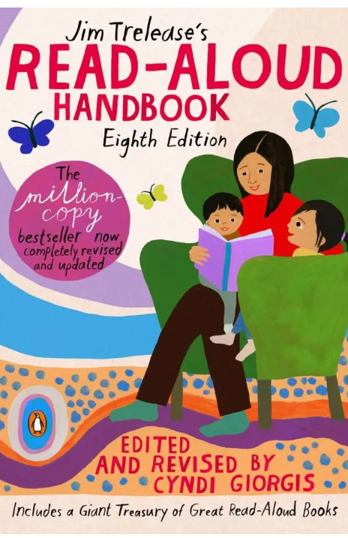
Why read aloud ?
In the 1960s, Trelease spent every evening reading to his two children. He also volunteered at a school where he quickly noticed that students in some classes were reading a lot, yet students in other classrooms weren’t. Trelease soon realized that the students who read more frequently had a teacher who read aloud on a regular basis.
This sparked a fire in Trelease. He began seeking research to prove his hypothesis true: reading aloud to children “improves their reading, writing, speaking, listening – and, best of all, their attitudes about reading.” Reading alters educational outcomes

Slide 8
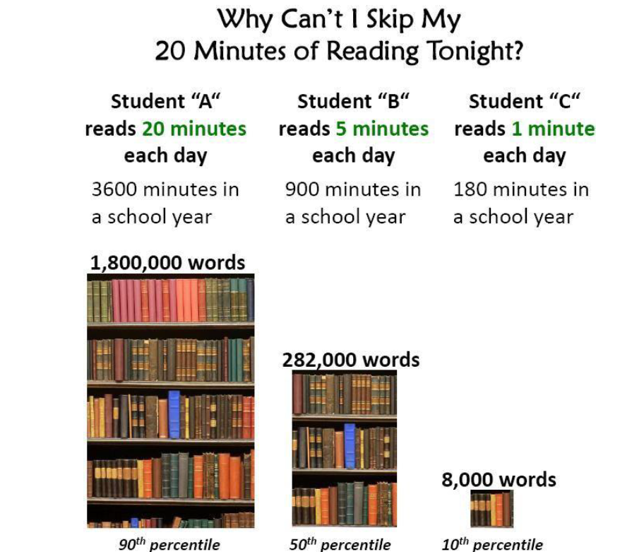

Slide 9
How should we do it ?
Your Child reading
Shared reading between adult and child – agree rules
Audio books – listen together and discuss
What to do with unknown words

Slide 10
What are we aiming for ?
In Year 6 children sit SATs. In a reading paper they will be expected to read texts and answer questions covering
2a – give or explain the meaning of words in context
2b – retrieve and record information or identify key details
2c – summarise main ideas from more than one paragraph
2d – make inferences from the text and justify these
2e – Predict what might happen from details stated and implied
2f – Identify and/or explain how information or narrative content is related and contributes
2g – identify how meaning is enhanced through choices of words or phrases
2h – Make comparisons within the text.

Slide 11
Let’s try some questions!
Give out reading info and sats questions

Slide 12
Link between reading and attainment
There is a growing body of evidence which illustrates the importance of reading for pleasure for both educational purposes as well as personal development (cited in Clark and Rumbold, 2006).
• Evidence suggests that there is a positive relationship between reading frequency, reading enjoyment and attainment (Clark 2011; Clark and Douglas 2011).
• Reading enjoyment has been reported as more important for children’s educational success than their family’s socio-economic status (OECD, 2002).
• There is a positive link between positive attitudes towards reading and scoring well on assessments (Twist et al, 2007).
• Regularly reading stories or novels outside of school is associated with higher scores in assessments (PIRLS, 2006; PISA, 2009).
• International evidence supports these findings; US research reports that independent reading is the best predictor of achievement (Anderson, Wilson and Fielding, 1988)

Slide 13
Recommended Book lists
https://schoolreadinglist.co.uk/category/reading-lists-for-ks2-school-pupils/
https://www.thereaderteacher.com/key-stage-book-lists
https://www.booksfortopics.com/booklists/recommended-reads/year-3/

Slide 14
Any questions ?
If you would like to ask a more personal question related to your own child – please do write it on a post it note.

