Slide 1

Reception
Basic Skills Information
Evening 2025
Andrews’ Endowed C of E Primary School

Slide 2
Welcome!
Aims of presentation:
To share an overview of the Early Year’s curriculum
To share the basic skills for phonics, reading, writing and number
To share ideas on how you can support at home

Slide 3
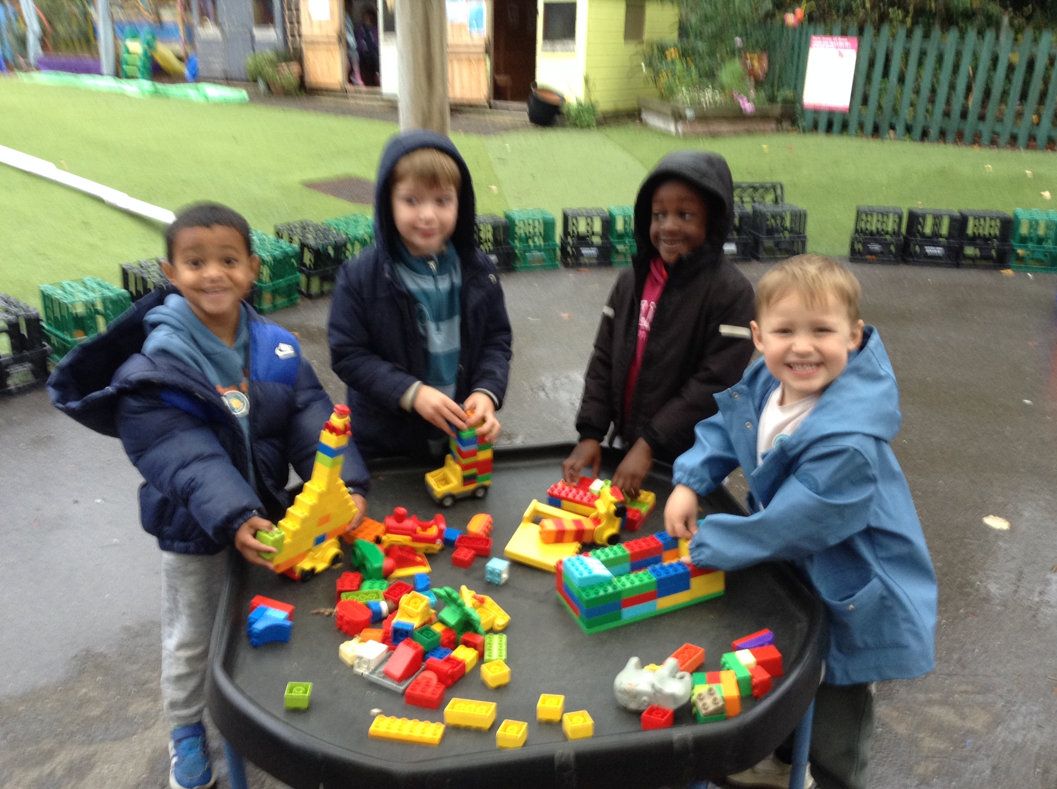
Working Together

Slide 4
The four principles of the EYFS
THE UNIQUE CHILD - Children respond to different learning methods and bring their own experiences and preferences to the setting. Every child is capable of being a strong, resilient learner with the right guidance.
ENABLING ENVIRONMENTS - The environment in which a child learns should prompt and encourage good learning techniques. An enabling environment is one that caters to each individual child's needs and gives them the freedom to expand their knowledge and development.
POSITIVE RELATIONSHIPS - Children should be encouraged to be strong and independent when required, forming the basis for positive relationships that they will go on to have. They should also be given the safety and security to bolster the relationships they have with those closest to them
LEARNING AND DEVELOPMENT - By following the EYFS Seven Areas of Learning, both Prime and Specific, each child will be taught a wide range of skills to aid their physical and mental development.

Slide 5
Characteristics of effective learning
Not “JUST PLAY”!
PLAYING & EXPLORING
Finding out & exploring
Being willing to have a go.
Playing with what they know.
ACTIVE LEARNING
Being involved and concentrating.
Keep on trying.
Enjoying achieving what they set out to do.
CREATIVE & THINKING CRITICALLY
Making links
Solving problems and having their own ideas.
Choosing ways to do things.

Slide 6
The Curriculum
The three prime areas are:
Personal, Social & Emotional development (PSED)
Communication & Language (C&L)
Physical Development (PD)
The specific areas are:
Mathematics - Number and Numerical pattern
Literacy – Comprehension, Word reading and Writing
Expressive Arts & Design (EAD)
Understanding the World (UTW)

Slide 7
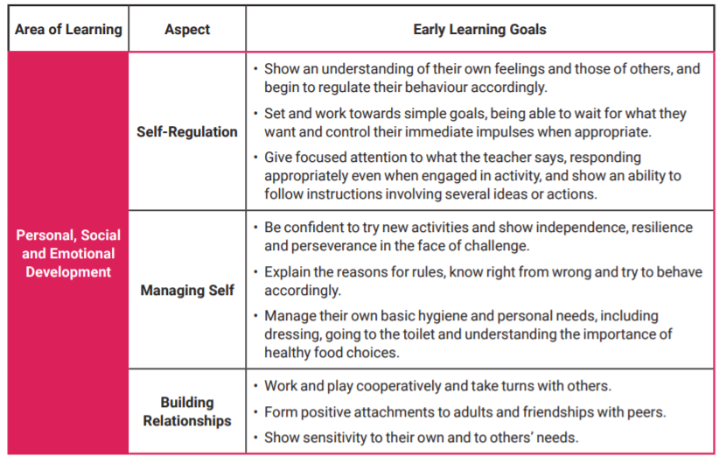
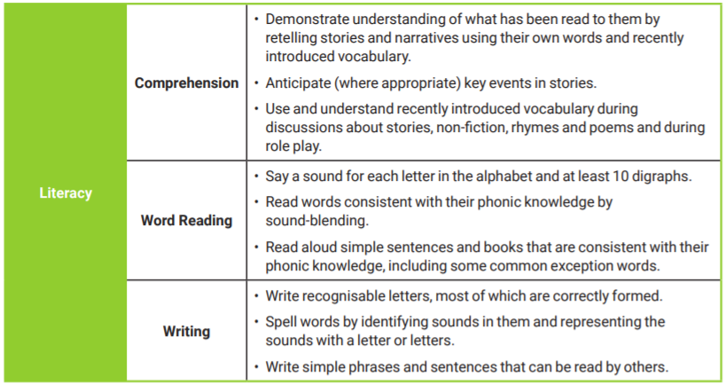
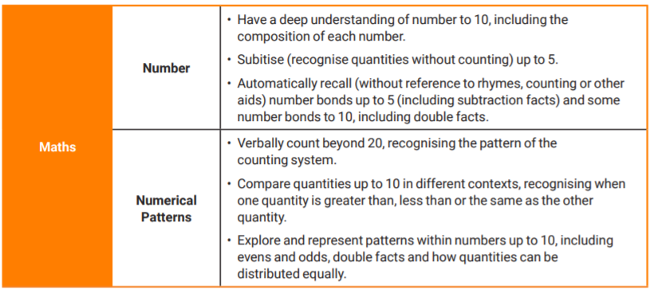
Early learning goals

Slide 8
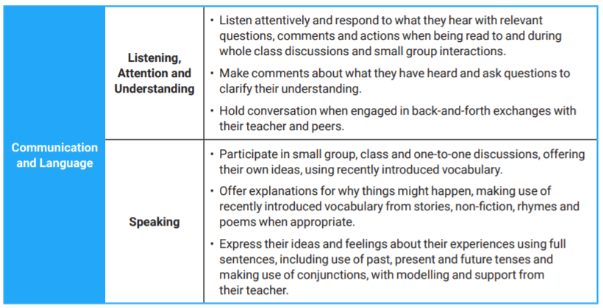
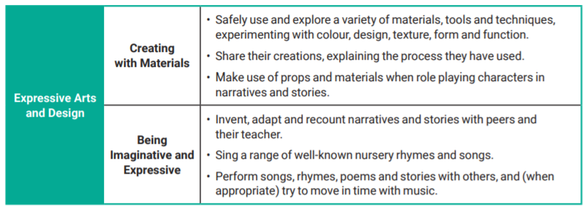
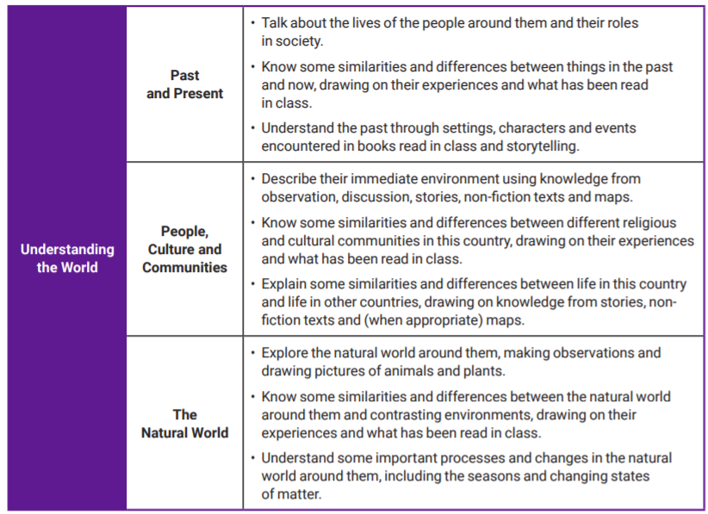
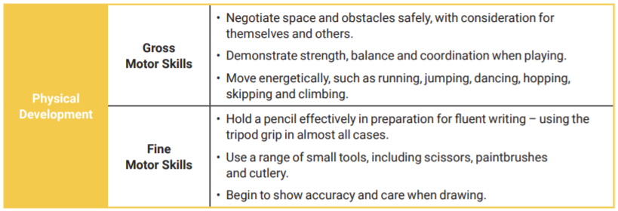

Slide 9
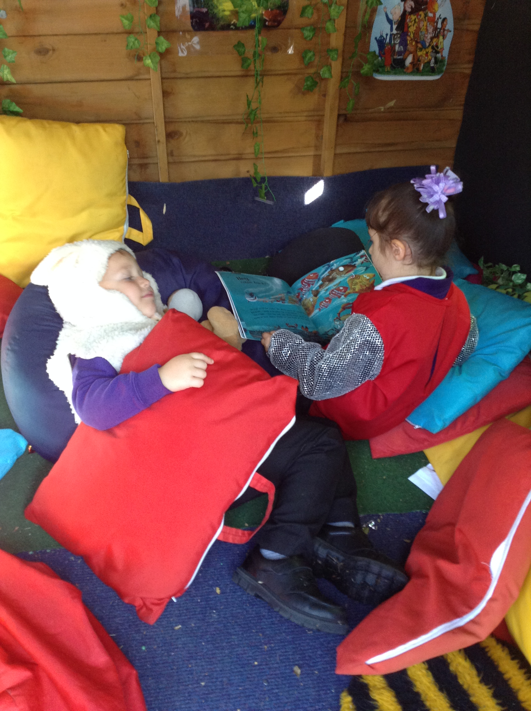
ELG Word Reading
Say a sound for each letter in the alphabet and at least 10 digraphs.
Read words consistent with their phonic knowledge by sound-blending.
Read aloud simple sentences and books that are consistent with their phonic knowledge, including some common exception words.

Slide 10
Phonics
There are 26 letters in the alphabet.
We use 44 sounds to speak in English
There are more than 144 ways to write the sounds as each sound can have different letters to represent it.

Slide 11
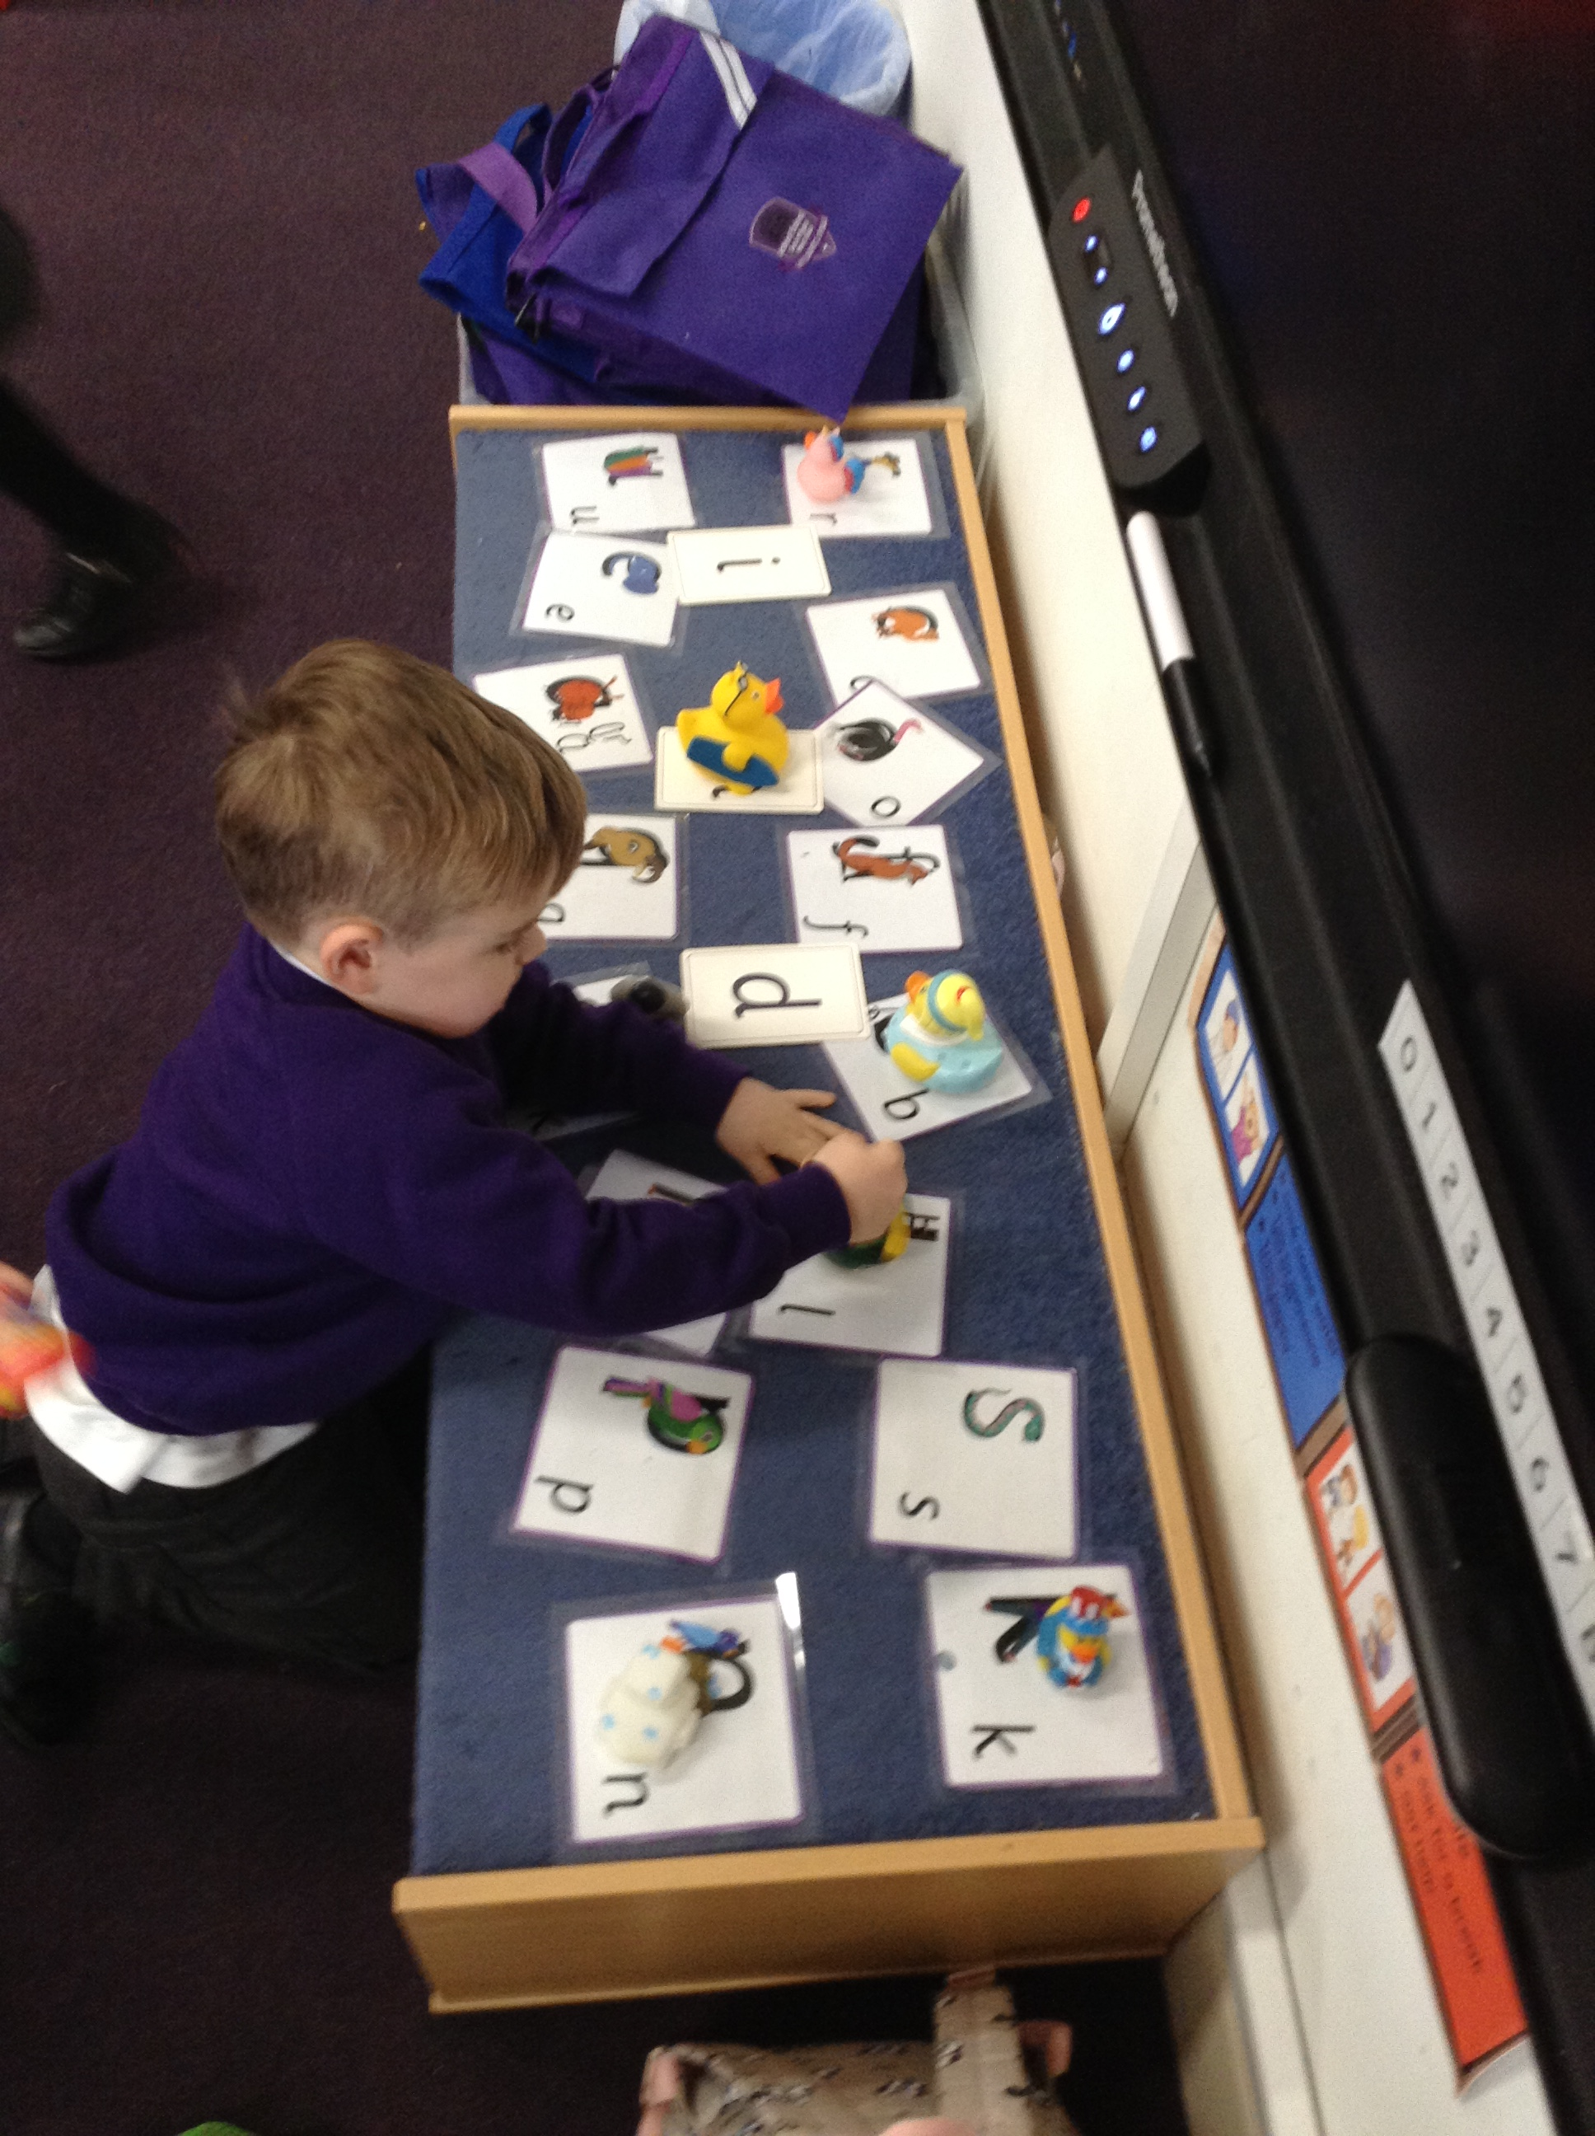
Teaching Phonics
Essential Letters and Sounds
  When and how?
  Teaching sequence

Slide 12
Terminology
Phonemes – smallest unit of sound (eg a, d, j)
Graphemes – the letter or sequence of letters that represent a phoneme (sound)
Digraphs – two letters which make one phoneme (sh, ck, ff, ai, ar, oy)
Trigraphs - three letters which make one phoneme (dge, igh)
Split digraphs - a digraph in which two letters are not adjacent (the a-e in make or the i-e in kite) – not magic ‘e’.
tent shift bridge slide

Slide 13
c a t
CVC words
sh o p

Slide 14
CCVC words
hand lamp
bend found

Slide 15
High Frequency words & Harder to read and spell words.
In Reception, your child will be given some high frequency words and HTR to learn over the year – the aim is for them to be able to recognise these words and to be able to read them by sight. Children learn these words as part of their phonics lessons and will also bring some words home to read.

Slide 16
Read by sight
the
and
a
to
said
was
you

Slide 17
Supporting Reading at home
4 main skills we want them to develop
  Love of books - Talking about the stories and books is an important part of reading and shows understanding!
  Knowing how books work
  Letter recognition
  Phonic Skills
Reassurance / time to have a go and apply strategies learnt
Decoding strategies
  Word recognition (keywords)
  Use of phonics - sounding out and blending known phonemes
  Using the pictures
  Grammatical knowledge

Slide 18
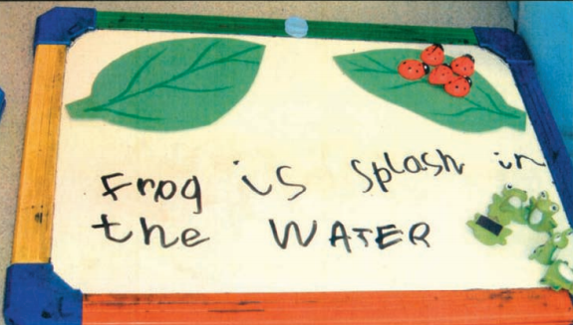
ELG Writing
Write recognisable letters, most of which are correctly formed.
Spell words by identifying sounds in them and representing the sounds with a letter or letters.
Write simple phrases and sentences that can be read by others

Slide 19
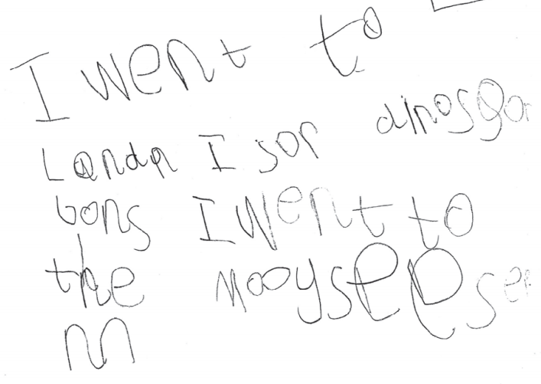

Slide 20
Supporting writing at home
Letting the children see you write
Pointing out environmental print
Imaginative writing- stories, poems and songs
Through hearing lots of stories – language and
sentence development.

Slide 21
ELG Maths - Number
Have a deep understanding of number to 10, including the composition of each number.
Subitise (recognise quantities without counting) up to 5.
Automatically recall (without reference to rhymes, counting or other aids) number bonds up to 5 (including subtraction facts) and some number bonds to 10, including double facts.

Slide 22
ELG Maths – Numerical pattern
Verbally count beyond 20, recognising the pattern of the counting system.
Compare quantities up to 10 in different contexts, recognising when one quantity is greater than, less than or the same as the other quantity.
Explore and represent patterns within numbers up to 10, including evens and odds, double facts and how quantities can be distributed equally

Slide 23
How to support your child at home:
Assigned home learning (Mathletics)
Board games
Counting games and songs
Music- to hear and repeat rhythm
Word play- ‘I spy’
Conversation – development and extension of vocabulary
Cooking (maths and reading)
Sounding out words. ‘Put on your r- e -d coat’
Physical development – climbing, riding bikes, upper body activities to assist with pencil control
Fine motor activities such as loom bands, weaving.
Mathletics – sign in details given to each child.

Slide 24
Gentle reminders
Label all items of clothing– uniform and PE kits
Named water bottles – water only
Reading books are being changed once a week. on a Friday
Home learning – set each week - newsletter
Celebrating the children’s learning:
Mathletics certificates
Head Teacher Awards

Slide 25

Thank you!
Notes:
Thank you!

