Slide 1
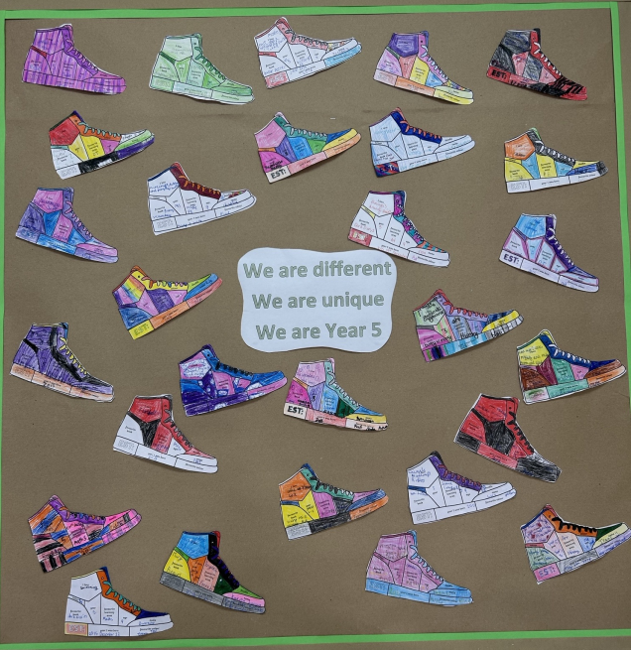
Welcome to Year 5

Slide 2
Miss Daffey (Mon-Tues)
Miss Mills (Weds-Fri)
Mrs Mason (Weds pm)
Mrs Driscoll (mornings)
Staff

Slide 3
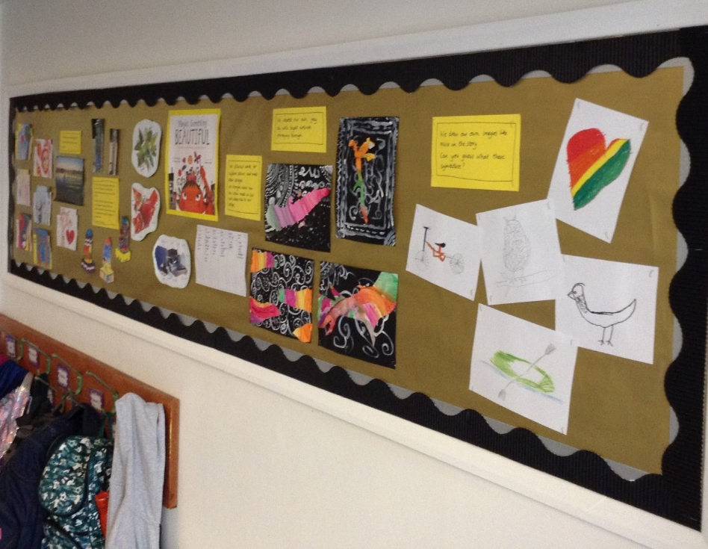
Responsibility
Resources
Attitude
Belongings
Upper KS2

Slide 4
Out of this world (Space)
Seeing is believing (Rivers)
Rainforests
Hardship (Vikings)
Wellbeing
Wisdom (Maya)
Topics

Slide 5
PE
Tuesday and Thursday
Shorts for gym
Hair / earrings

Slide 6
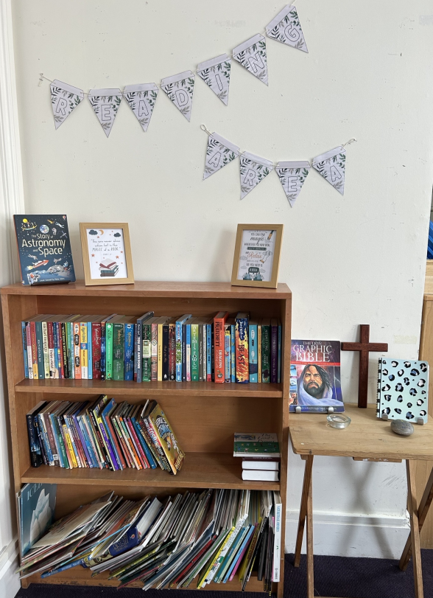
Please continue to read with your child every day.
Reading

Slide 7
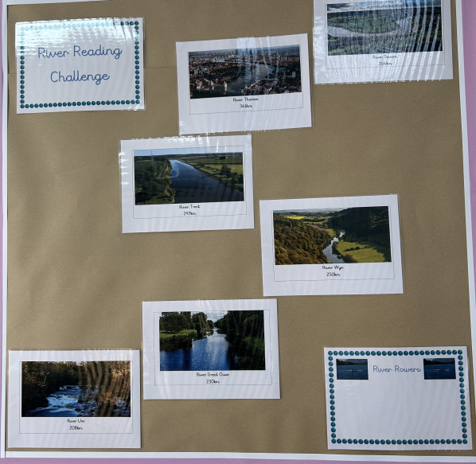
Reading
Reading challenge

Slide 8
Homework
Set on a Thursday
Handed in by Tuesday
Spelling
Maths – Mathletics
English/Topic

Slide 9
Writing
Joined handwriting
Happy to have own pencil cases(small!) – may use their own blue pen
No biro

Slide 10
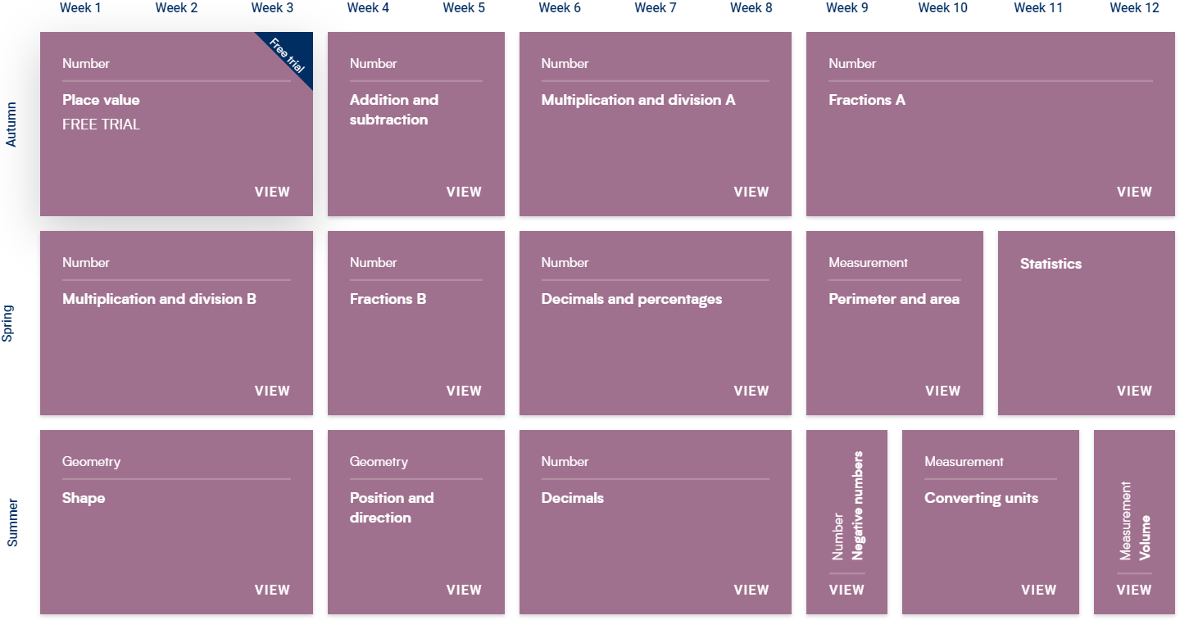
Connections, mistakes
Maths

Slide 11
Rewards
House points
Homework award winners
Star of the week
Head Teacher awards

Slide 12




Growth Mindset
School Values
Love, Courage, Respect

Slide 13
Being honest about:
Their understanding
Their own next steps
Friendships
Feelings
Choices they have made

Slide 14
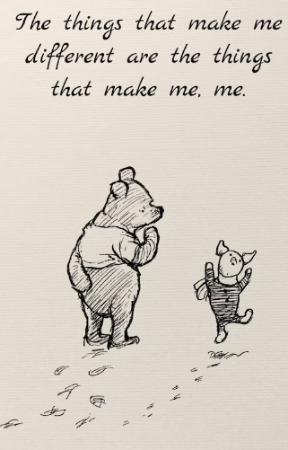

Quotes
High aspirations, moral strength, spiritual depth

Slide 15
Please don’t hesitate to contact us if you have any questions or concerns – however small.
Phone call, email, face to face
Communication:

